Slide 1
Attrition Data Analysis
SilverNeuron Consulting
July 25, 2020

Slide 2
Purpose of Analysis
A dataset related to Attrition has been analyzed to derive insights about which factors affect the decision to stay or leave a company
Attrition analysis assists the company to ascertain reasons for employee exits
This study can lead a company’s actions to improve employee retention
It enables the company to develop long term strategies to reduce attrition as well as to make new recruitments

Slide 3
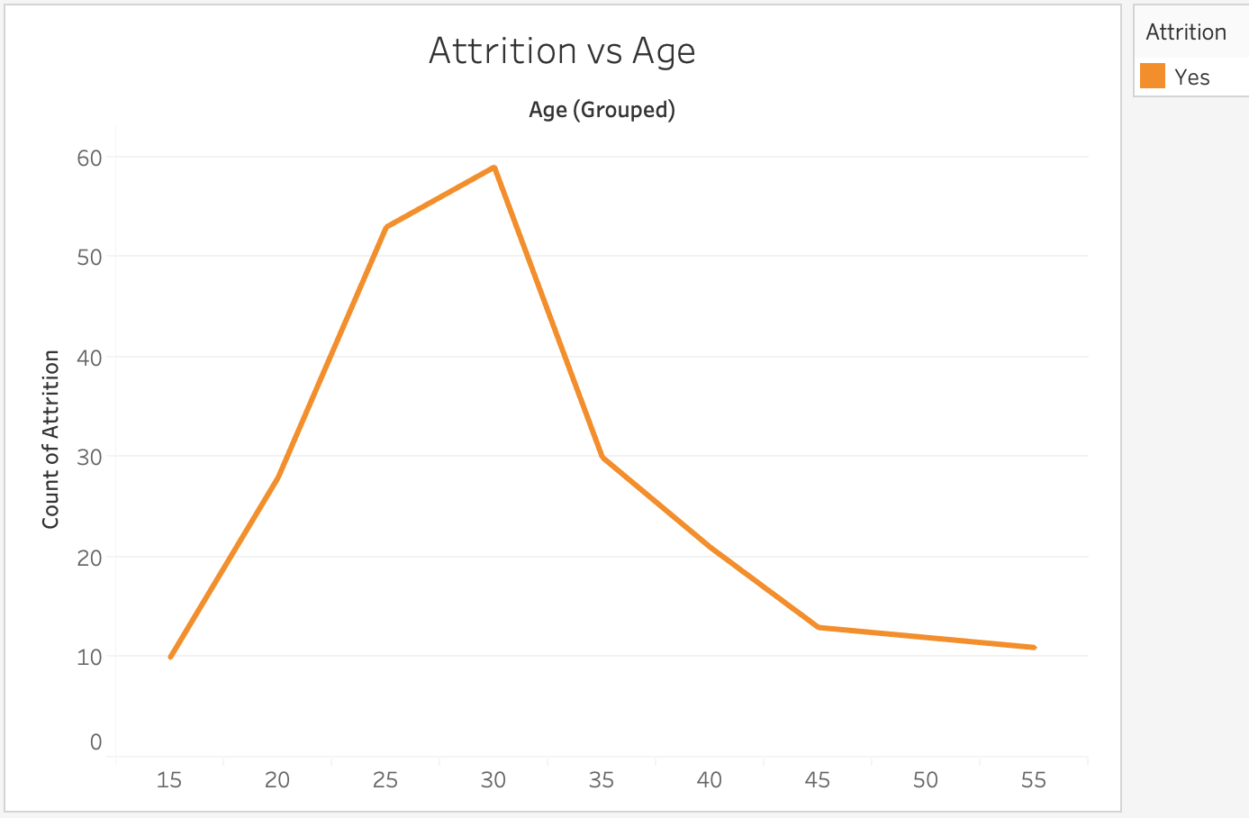
Attrition vs Age
INSIGHTS:
Age has been grouped into bins
The employees between the ages of 20 and 35 are more likely to leave the company
Those who are close to retirement are less likely to leave

Slide 4
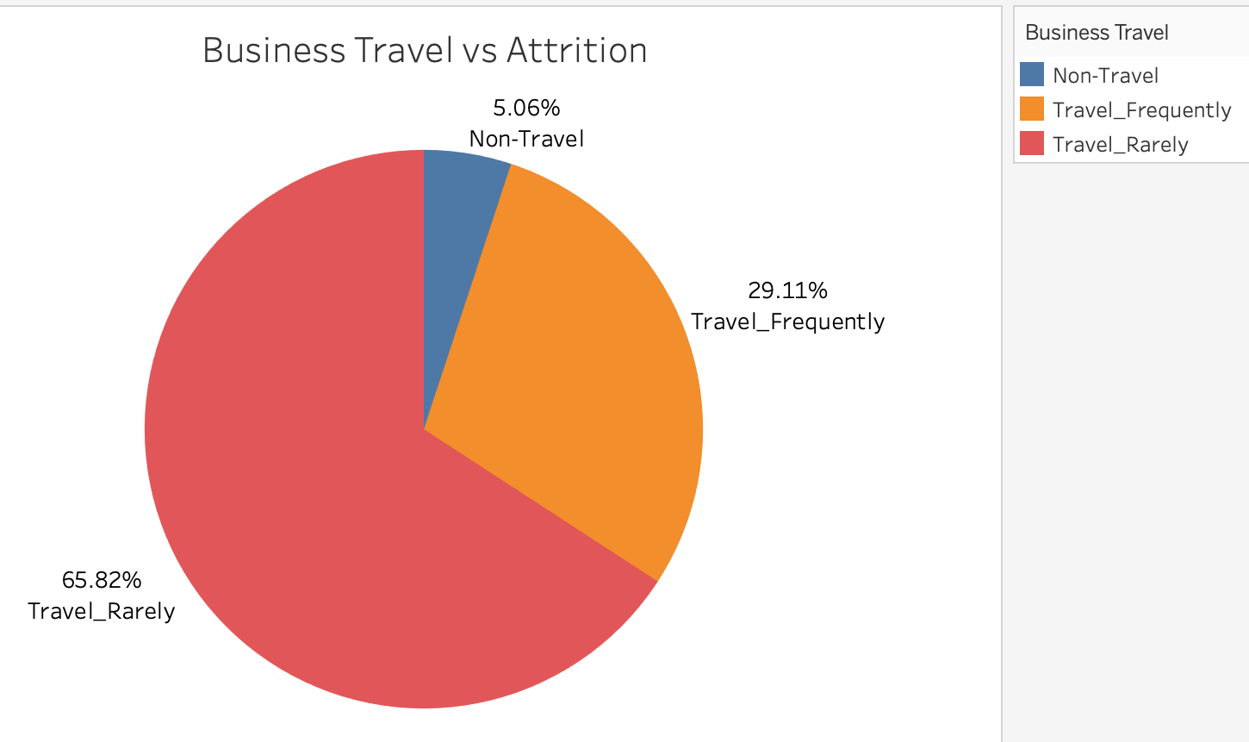
Business Travel vs Attrition
INSIGHTS:
65.82% of people who leave the company travel rarely
29.11% of people who leave the company travel frequently
5.06% of people who leave the company do not travel at all

Slide 5
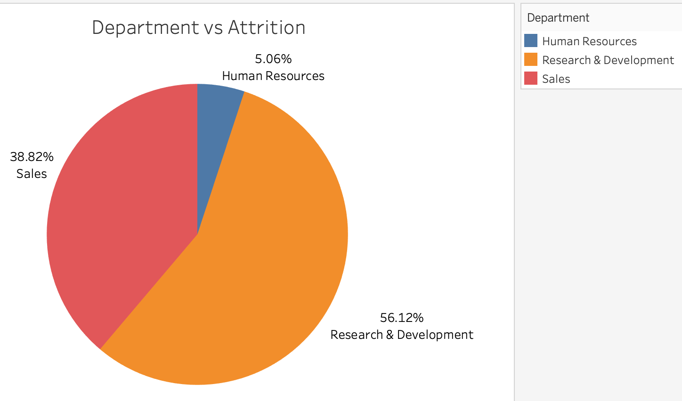
Department vs Attrition
INSIGHTS:
56.12% of people who leave the company are from R&D
38.82% of people who leave the company are from Sales
5.06% of people who leave the company are from HR
More than half of the people who leave the company are from R&D department

Slide 6
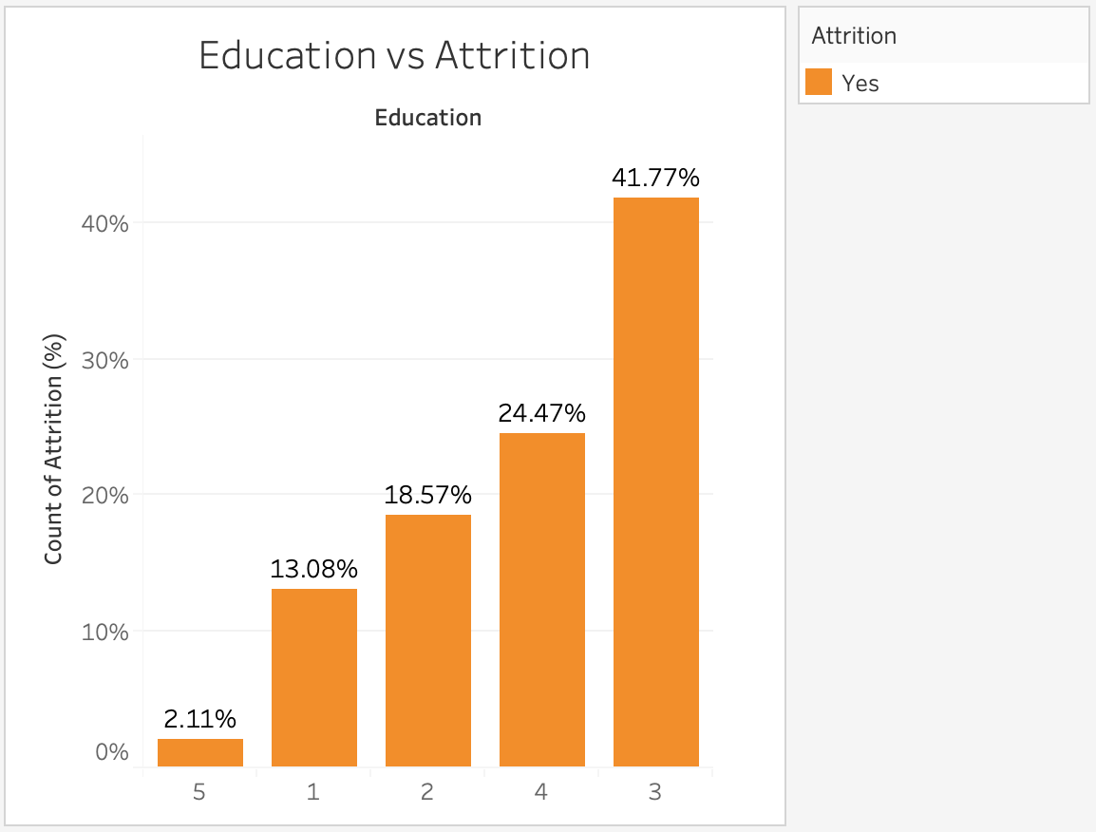
Education vs Attrition
INSIGHTS:
1 represents the lowest education level while 5 represents the highest
The employees who are most likely to leave the company belong to the middle education level, represented on the graph by 3 at 41.77%
The employees who are least likely to leave the company are those who are most educated, making up 2.11% of all attrition

Slide 7
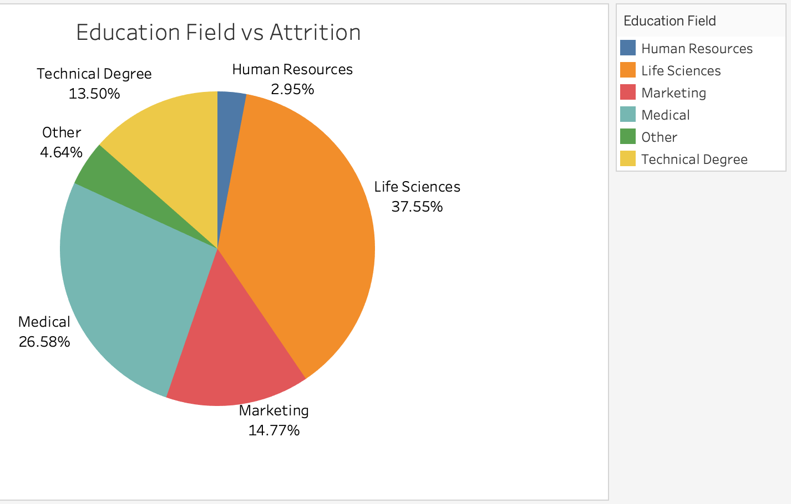
Education Field vs Attrition
INSIGHTS:
37.55% of people who leave the company have studied Life Sciences
People who have studied in science related fields are more likely to leave the company

Slide 8
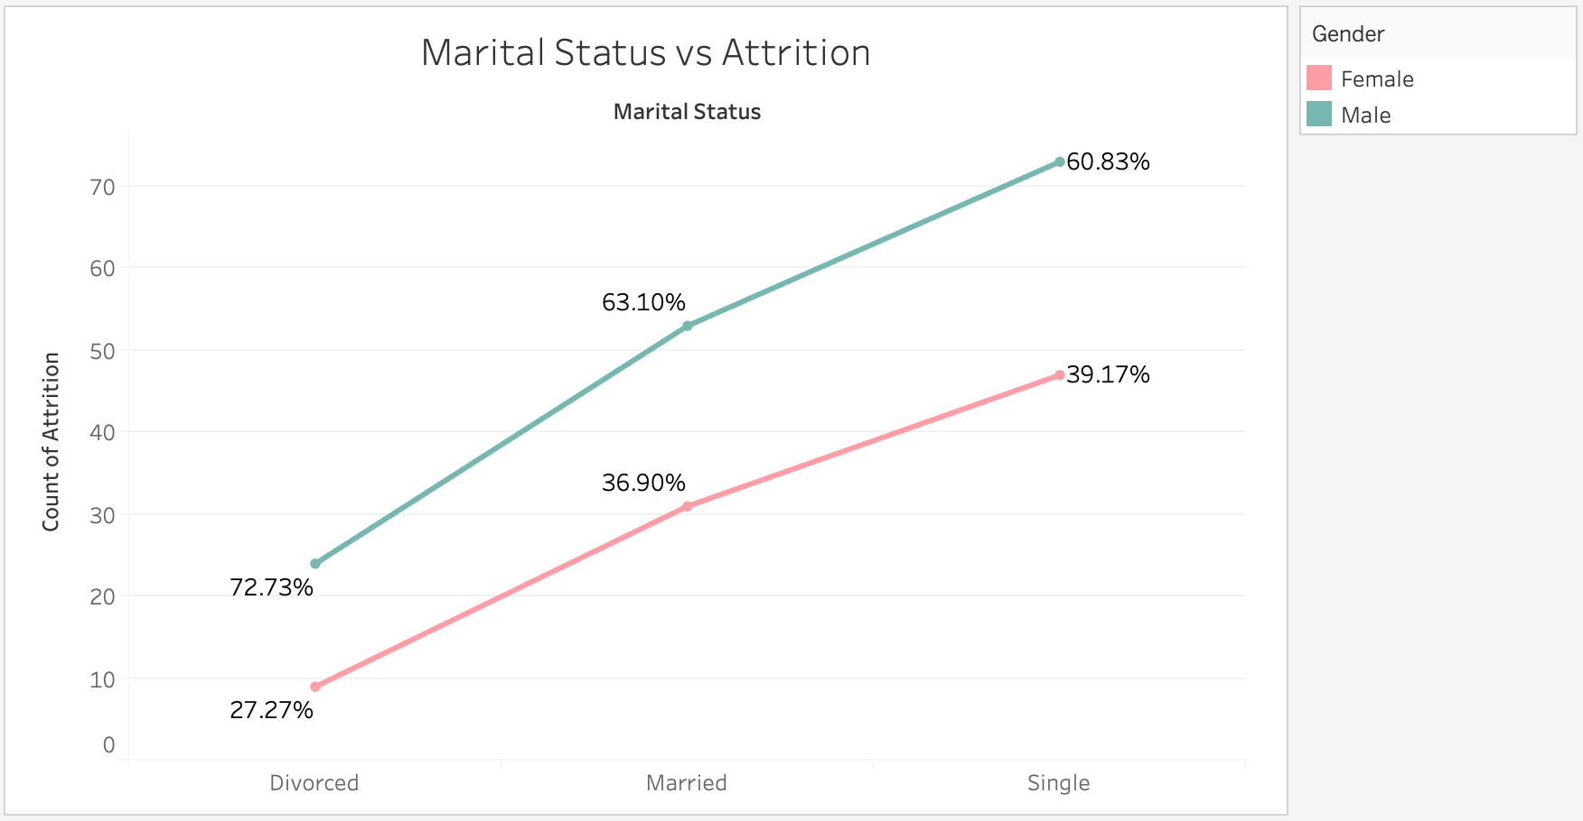
Marital Status vs Attrition
INSIGHTS:
72.73% of Divorced employees who leave the company are Male
60.83% of Single employees who leave the company are Male
Single employees who leave the company exceed the other categories
Male employees are more likely to leave the company compared to females

Slide 9
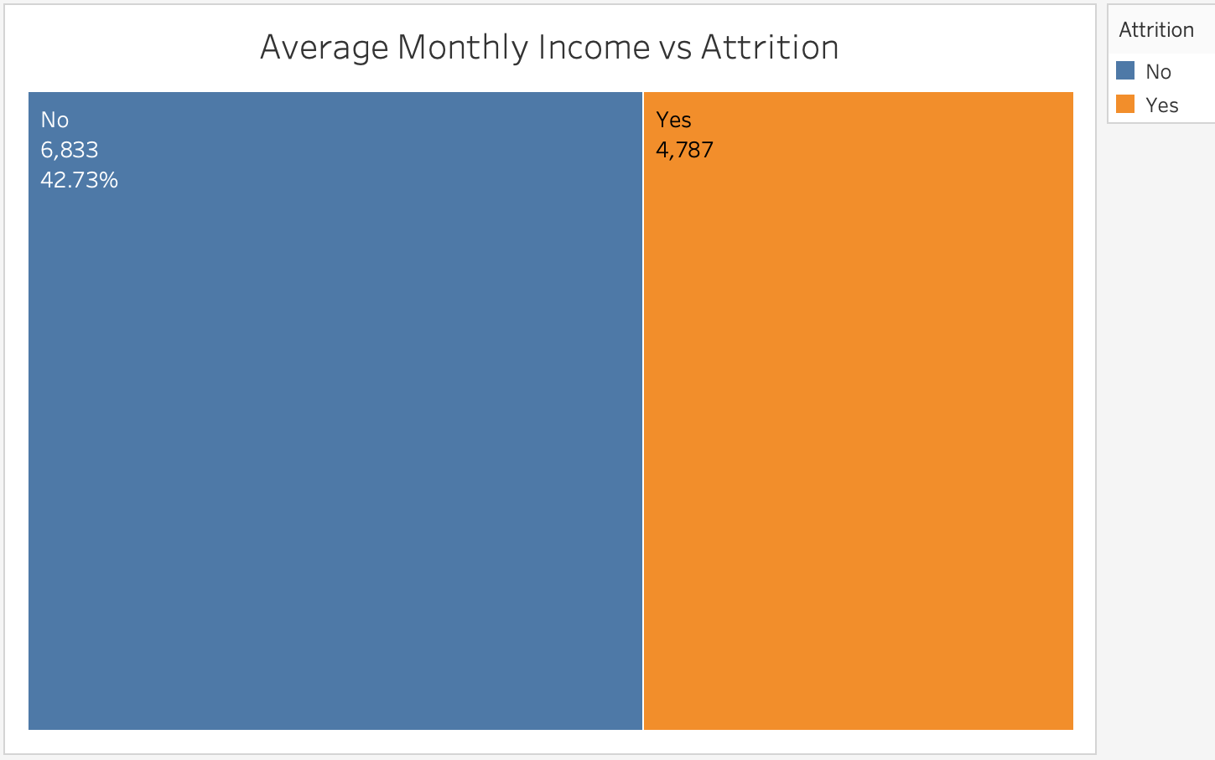
Average Monthly Income vs Attrition
INSIGHTS:
The average income of employees who will stay in the company is 42.73% greater than that of those who will leave
Employees with more income are most likely to stay in the company

Slide 10
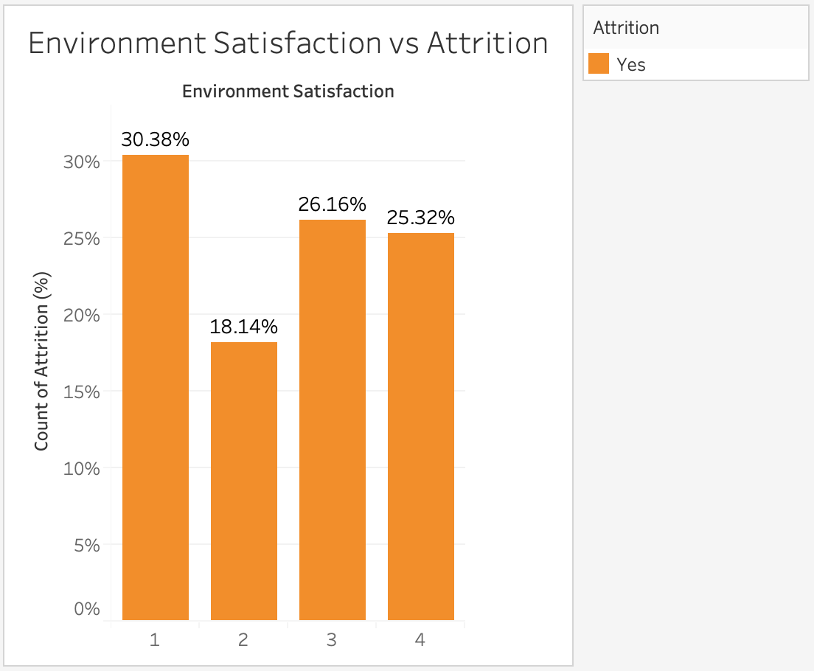
Environment Satisfaction vs Attrition
INSIGHTS:
1 represents least satisfied while 4 represents most satisfied
Out of all employees who have chosen to leave the company, 30.38% of them were least satisfied by the work environment

Slide 11
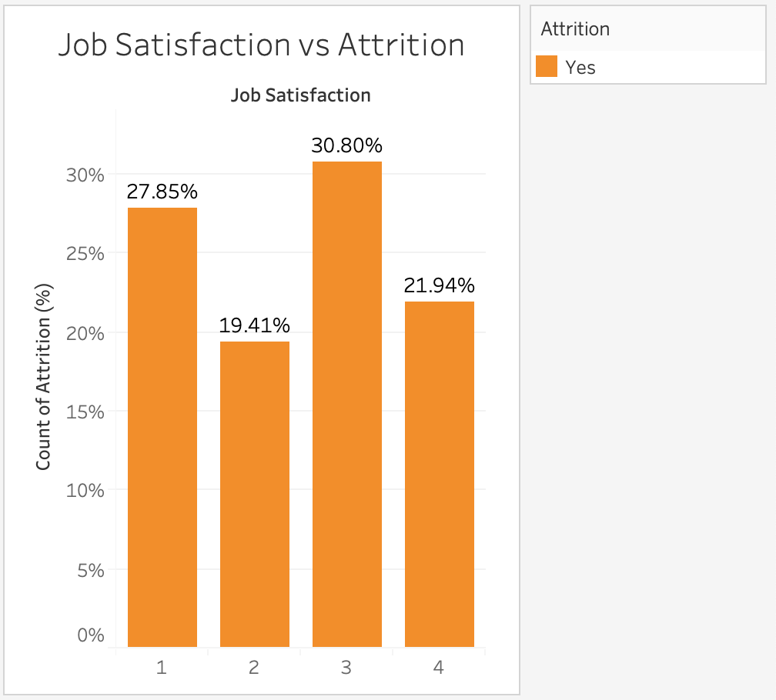
Job Satisfaction vs Attrition
INSIGHTS:
1 represents least satisfied while 4 represents most satisfied
Out of all employees who have left the company 27.85% of employees were least satisfied by their jobs while 30.80% were decently satisfied

Slide 12
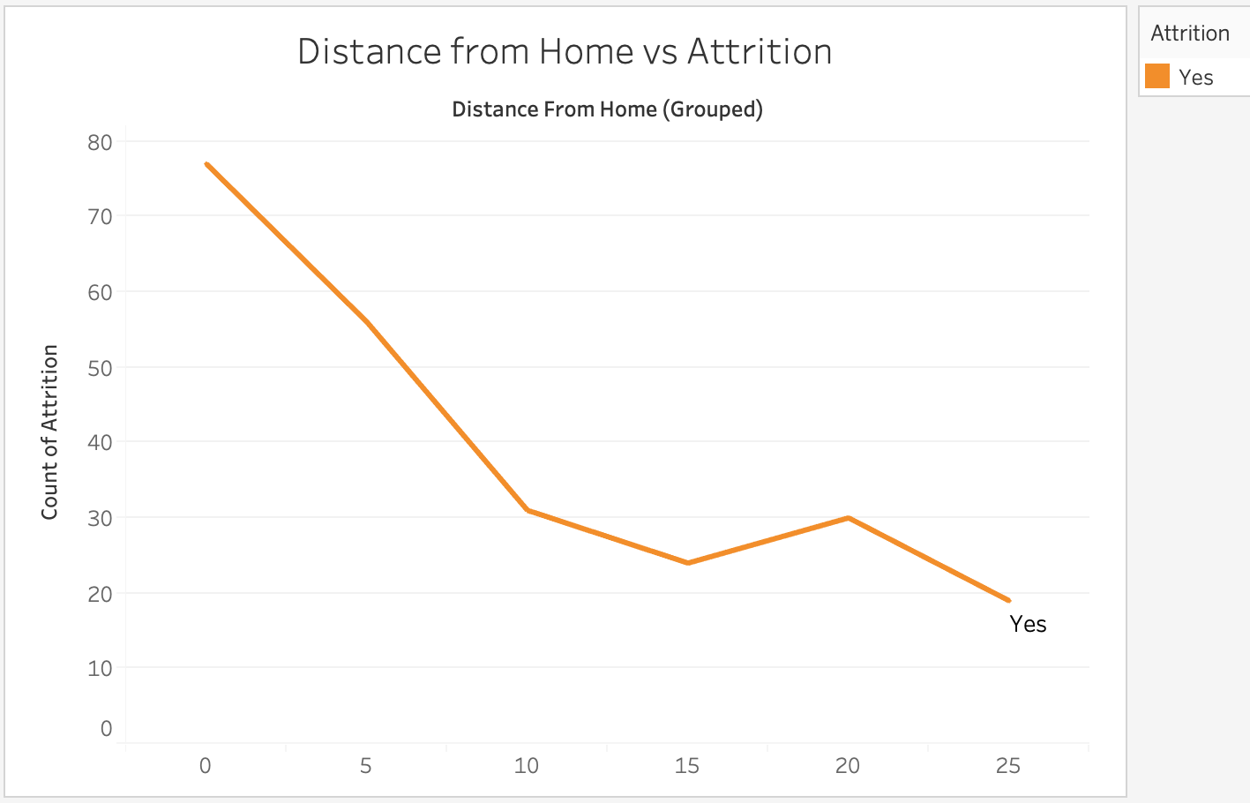
Distance from Home vs Attrition
INSIGHTS:
The attrition rate is greater for those who live closer to the company than for those whose distance from home is larger
It is a contradiction to the normal belief that people who live near to the workplace are more likely to stay

Slide 13
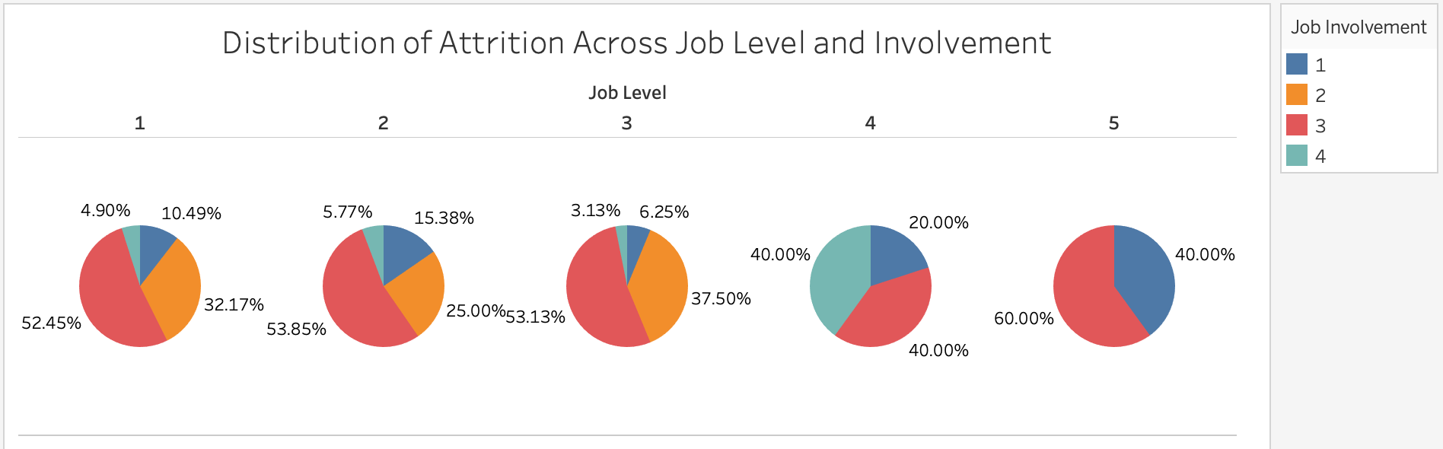
Distribution of Attrition Across Job Level and Involvement
INSIGHTS:
Across all the Job Levels, those whose involvement (on a scale of 1-4) is 3 are more likely to leave the company
Example: At Job Level 1, 52.45% of employees who have left belong to Job Involvement category 3

Slide 14
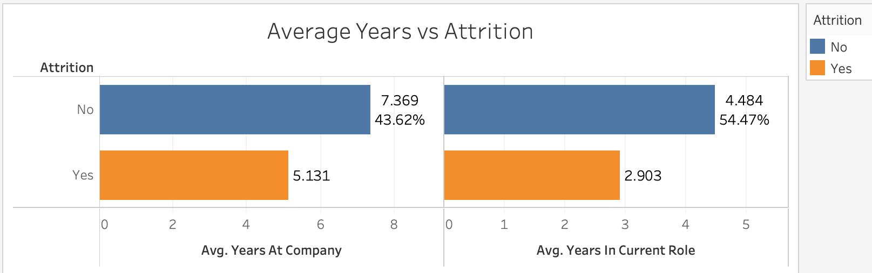
Average Years vs Attrition
INSIGHTS:
For employees who chose to stay in the company, the average years at the company and the average years in the current role is greater by 43.62% and 54.47%, respectively

Slide 15
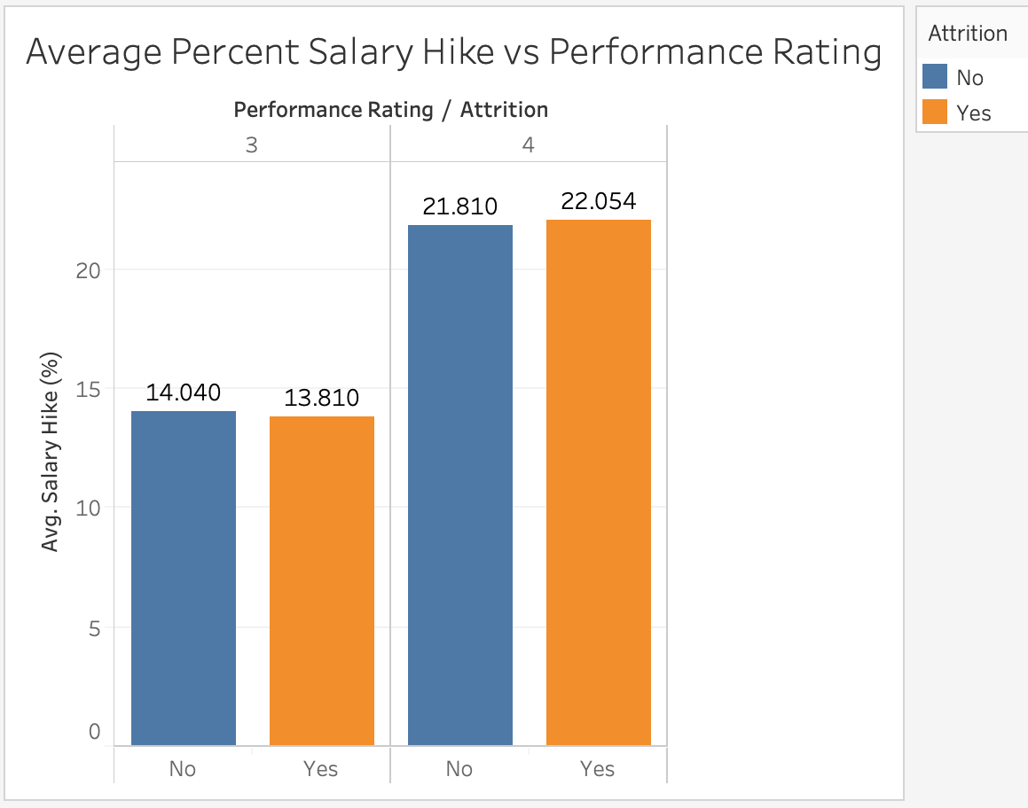
Average Percent Salary Hike vs Performance Rating
INSIGHTS:
For both the Performance Ratings, the difference between the Average Percent Salary Hike for those employees who chose to leave and those who have chosen to stay is very minute
A higher Performance Rating = A higher Average Percent Salary Hike

Slide 16
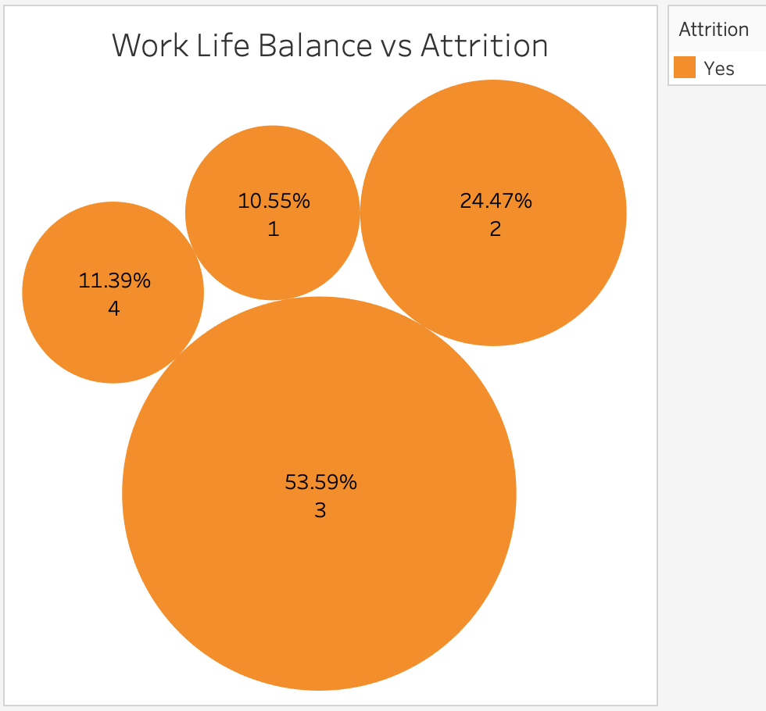
Work Life Balance vs Attrition
INSIGHTS:
Represented on a scale from 1-4 with 1 being least balanced and 4 being most balanced
53.59% of the employees who left fall in the 3 range → they felt they have been able to have a decent work life balance

Slide 17
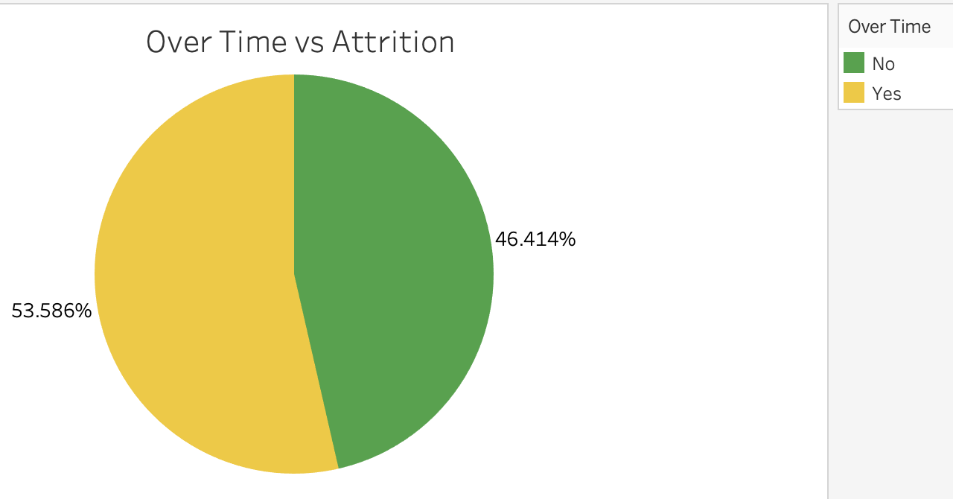
Over Time vs Attrition
INSIGHTS:
53.586% of employees who have left the company did have to work over time

Slide 18
Consolidated thoughts: Strategic Retention Plan
Monthly Income: people on higher wages are less likely to leave the company. Hence, efforts should be made to gather information on industry benchmarks in the current local market to determine if the company is providing competitive wages.
Over Time: people who work overtime are more likely to leave the company. Hence efforts must be taken to appropriately scope projects upfront with adequate support and manpower so as to reduce the use of overtime.

Slide 19
Consolidated thoughts: Strategic Retention Plan
Age: Employees in relatively young age bracket 25-35 are more likely to leave. Hence, efforts should be made to clearly articulate the long-term vision of the company and young employees fit in that vision, as well as provide incentives in the form of clear paths to promotion for instance.
Total Working Years: The more experienced employees are less likely to leave. Employees who have between 5-8 years of experience should be identified as potentially having a higher-risk of leaving.
The dataset features three marital statuses: Married (673 employees), Single (470 employees), Divorced (327 employees). Single employees show the largest proportion of leavers at 25%.

Slide 20
Models Used
Random Forest Model
Support Vector Machines
Logistic Regression
K Neighbours Classifier
XGBoost

Slide 21
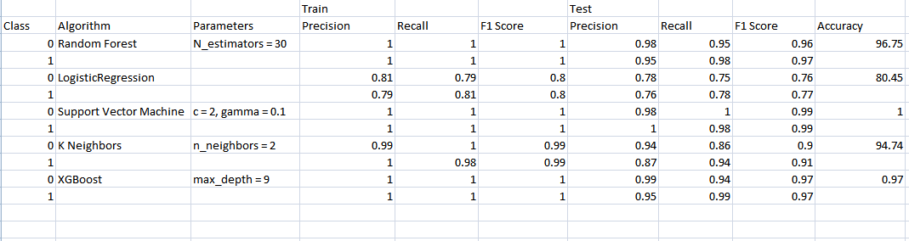
Metrics

Slide 22
Final Conclusion
From the above all metrics and considering the size of dataset and features, we can opt for the Support Vector classifier as our model for the project, as it gives us the maximum accuracy (100%) amongst all models considered. It has low bias and variance as well

Slide 23
Appendix
Changes made to the dataset are as follows:
Classified the column “Attrition” by changing 0s to “No” and 1s to “Yes.
The dataset was imbalanced (was biased towards No) so it was balanced using the oversampling method

Slide 24
THANK YOU

